Slide 1
EDA Case Study By: Amitesh Shrivastava and Lewin Antao

Slide 2
Application Data

Slide 3
Data Cleaning
Columns having more than 30% of null values are ignored for the analysis
Columns having lesser percentage of null values are imputed either using mean, median or mode
The columns whose values are continuous and doesn’t show much variation are imputed using mean
The columns whose values are highly skewed are imputed by mode(the most common value on the set)

Slide 4
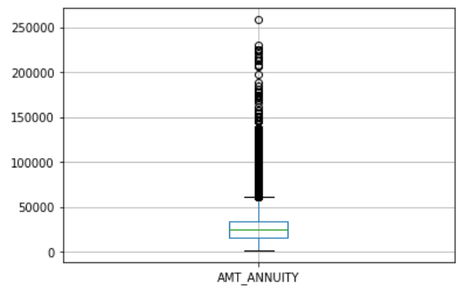
Data Cleaning – Removing null values
Column Name: AMT_ANNUITY
Annuity amount depends on the amount taken for loan.
Most of the annuity amount lies within 60000 approx.
Null annuity amount probably means that customer has not started settling the loans
Null over here actually has a meaning; so we can impute null values with 0

Slide 5
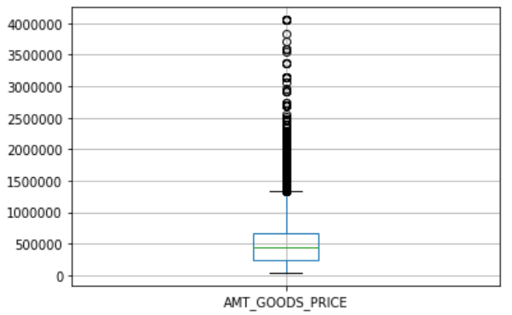
Data Cleaning – Removing null values
Column Name: AMT_GOODS_PRICE
The missing values over here cannot be imputed with another value int he AMT_GOODS_PRICE column as it will be wild guess.
Generally the loan taken by the customer is 80% of the total amount of his goods.
But to make it simple we can directly impute the corresponding amount from the AMT_CREDIT column

Slide 6
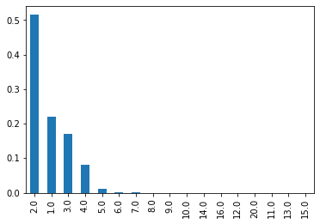
Data Cleaning – Removing null values
Column Name: CNT_FAM_MEMBERS
50% of the family have 2 members
Next highest is quite low
Imputing the null values with 2

Slide 7
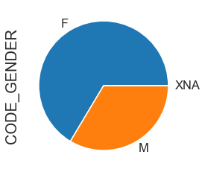
Data Cleaning – Removing null values
Column Name - CODE_GENDER
Majority of the loan applicants are female
Imputing the missing values with ‘F’

Slide 8
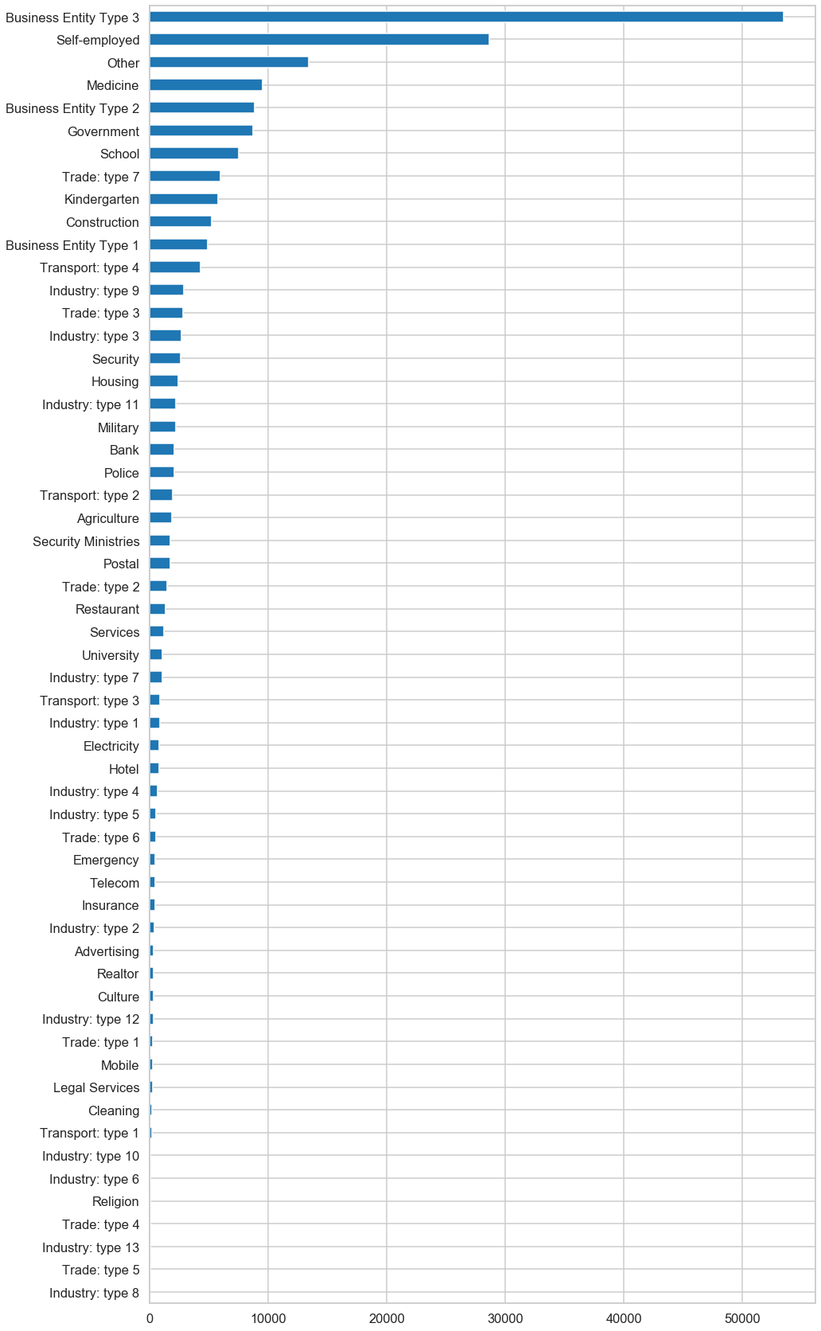
Data Cleaning – Removing null values
Column Name - ORGANIZATION_TYPE
There are quite a few XNA's; we cannot impute these XNA's with any other value as there is no clear standout organization type.
We can impute these records with ‘Other’

Slide 9
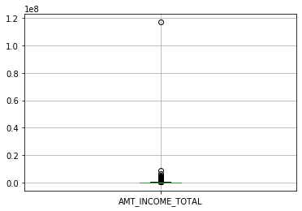
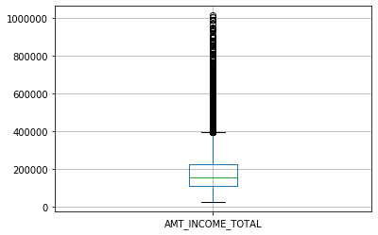
Univariate Analysis - Treating Outliers
Column Name - AMT_INCOME_TOTAL
There’s a clear cut outlier
We can treat this by either Z-score method or IQR method
Fig-1 is before the treatment
Fig-2 is after the treatment
Fig-1
Fig-2

Slide 10
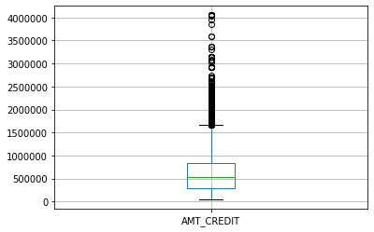
Univariate Analysis – Treating of outliers
Column Name: AMT_CREDIT
Doesn't seem to be an outlier here; no treatment required

Slide 11
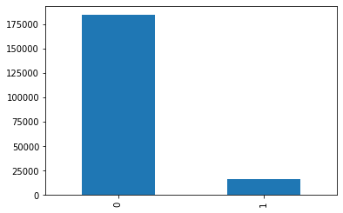
Imbalance Percentages of Target 1 and Target 0
There are 8% defaulters(Target 1)
92% are those who settled their loans
Aim is to identify factors affecting defaulters and settlers

Slide 12
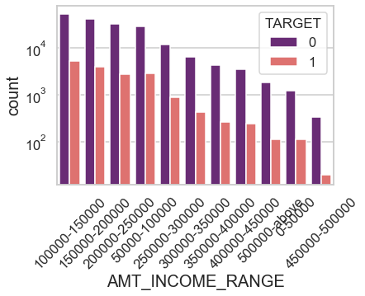
Univariate– Categorical Analysis
Column Name - AMT_INCOME_RANGE
Category – TARGET
Income range 100000-150000 has the most loan settlers and also has the most defaulters
The ratio of loan settlers wrt loan defaulters is quite high in the income range 450000 – 500000. Bank should target customers in this income range for good loans

Slide 13
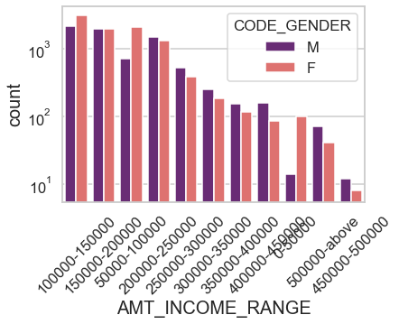
Univariate– Categorical Analysis
Column Name - AMT_INCOME_RANGE
The plot shows distribution of Target=1
Category – CODE_GENDER
Income range 100000-150000, 50000-100000 and 0-50000 are three income categories where more defaulters are Female wrt male
Rest of the income ranges have more male defaulters than Female

Slide 14
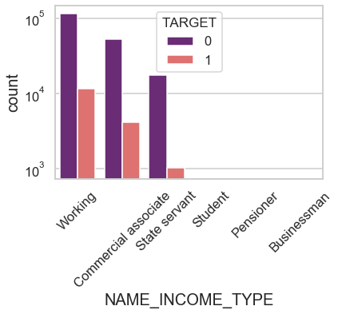
Univariate Analysis – Categorical Analysis
Column Name – NAME_INCOME_TYPE
Category - TARGET
Working class has the highest number of loan settlers
State servant is one category where loan settlers are quite high in number wrt loan defaulters

Slide 15
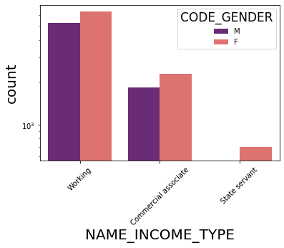
Univariate Analysis – Categorical Analysis
Column name - NAME_INCOME_TYPE
The plot shows distribution of Target=1
The ration of male defaulters vs female defaulters are quite same in Working and Commercial Associate class
Almost no male defaulters in State Servant category

Slide 16
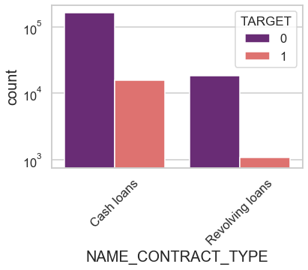
Univariate Analysis – Categorical Analysis
Column Name – NAME_CONTRACT_TYPE
Category – TARGET
Customers opting for Revolving loans have quite a few defaulters

Slide 17
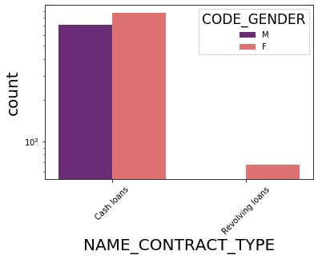
Univariate Analysis – Categorical Analysis
Column Name: NAME_CONTRACT_TYPE
This plot shows distribution for TARGET = 1
Female defaulters are more in Cash loans category
No male defaulters in Revolving loans category

Slide 18
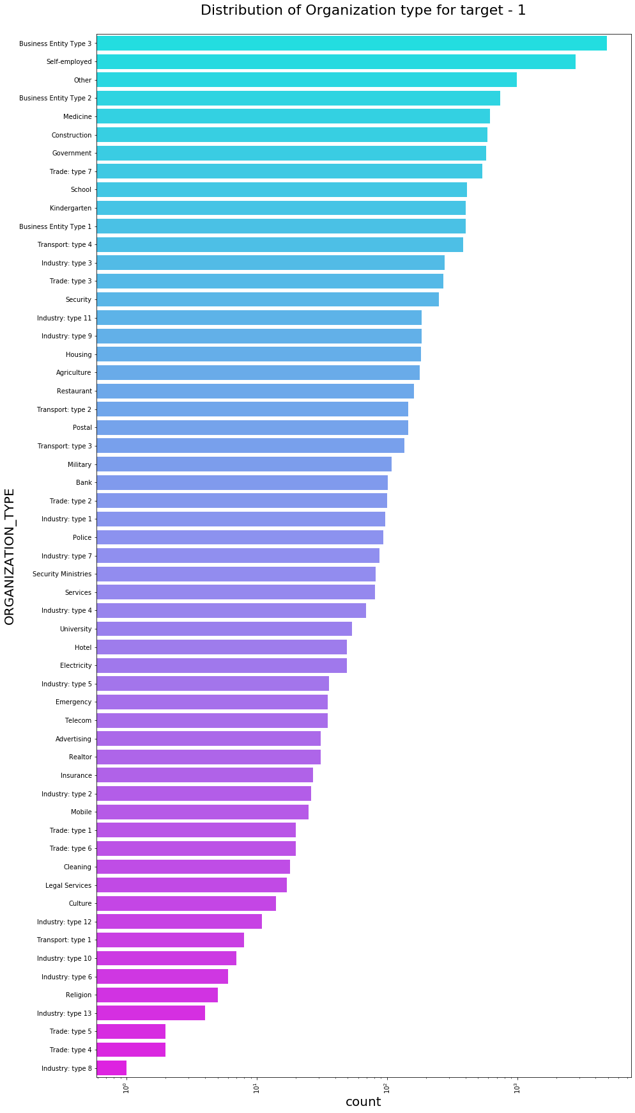
Univariate Analysis – Categorical Analysis
Column Name - ORGANIZATION_TYPE
Most no of defaulters are in the Organization Type - Business Entity Type 3
Least no of defaulters are in the Organization Type - Industry Type - 8

Slide 19
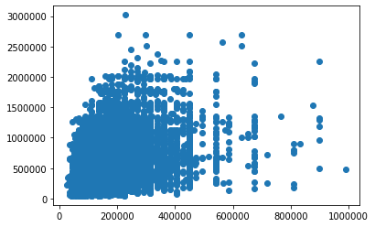
Bivariate Analysis – Numerical to Numerical
AMT_INCOME_TOTAL vs AMT_CREDIT
Most of the loans are in the income range < 400000

Slide 20
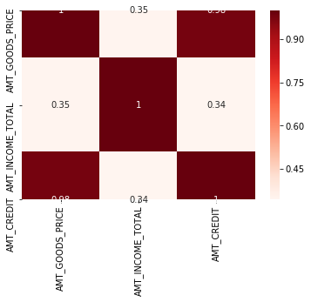
Bivariate Analysis – Numerical to Numerical
AMT_GOODS_PRICE', 'AMT_INCOME_TOTAL', 'AMT_CREDIT
An obvious observation: More the price of the goods more will be the credit amount
There's not much association between rest of the variables.

Slide 21
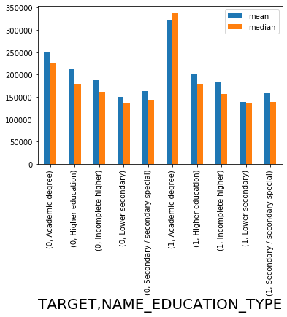
Bivariate Analysis
TARGET+EDUCATION_TYPE vs INCOME
Looks like high earning and academic degree holders are more vulnerable to default
Also the same category of customers(high earning and academic degree holders) are the ones who settle their loans most

Slide 22
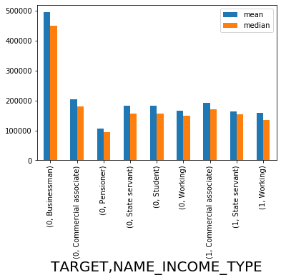
Bivariate Analysis
TARGET + INCOME_TYPE vs INCOME
Looks like high earning and businessman are the one who mostly settle their loans
Also the less earning working class customers are more vulnerable to default

Slide 23
Previous Application Data

Slide 24
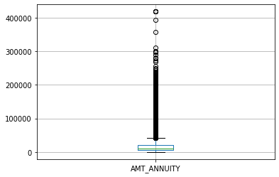
Univariate Analysis
Column Name - AMT_ANNUITY
Impute null values with mean

Slide 25
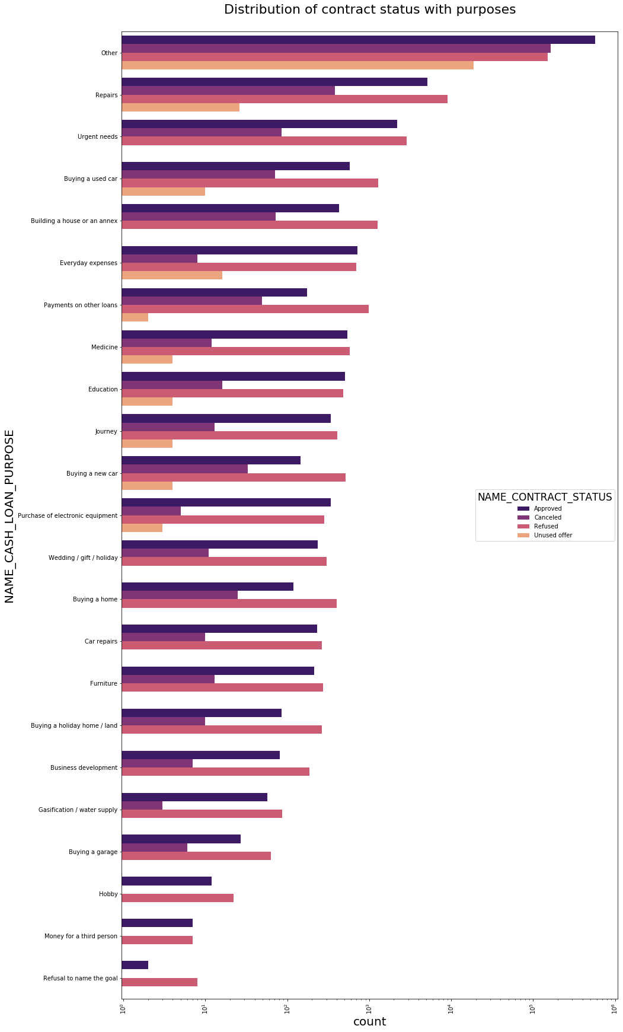
Bivariate Analysis
NAME_CASH_LOAN_PURPOSE
Most rejection of loans came from purpose 'Other' followed by 'Repairs' and 'Urgent Needs'

Slide 26
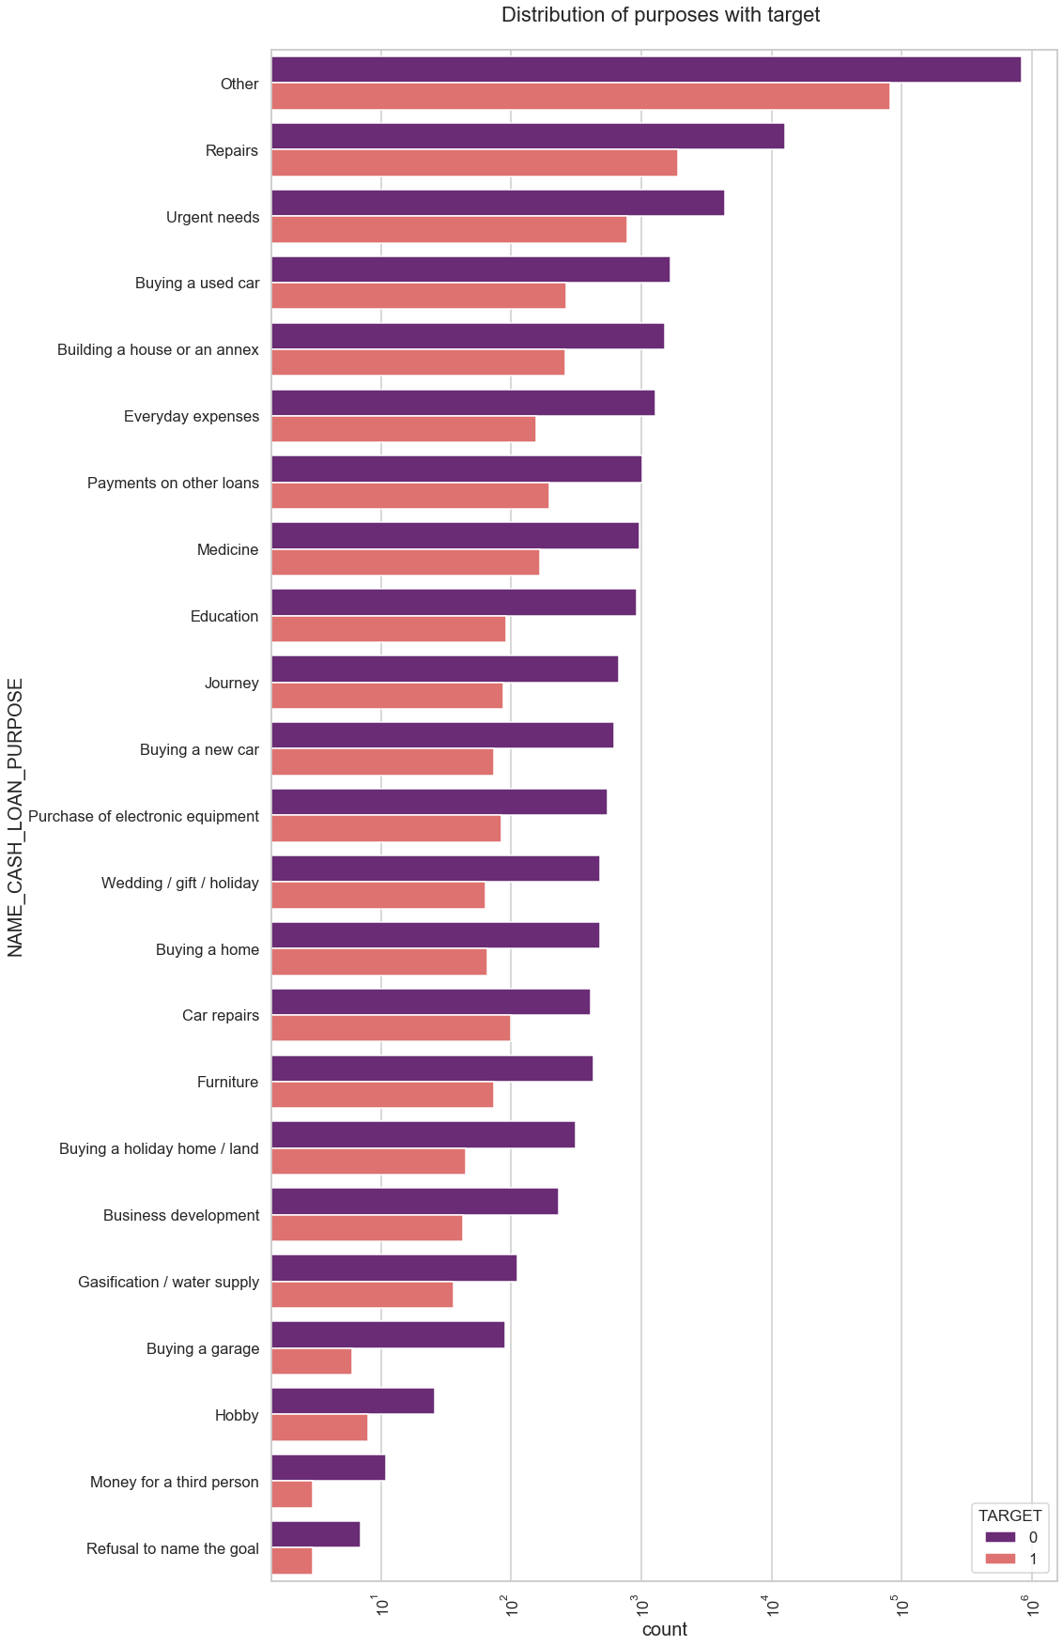
Bivariate Analysis
Loan purposes with 'Others' are facing more difficulties in payment on time.
There are few reasons where success rate is significantly higher than default rate - Buying a garage, Money for Third Person, Refusal to name the goal

Slide 27
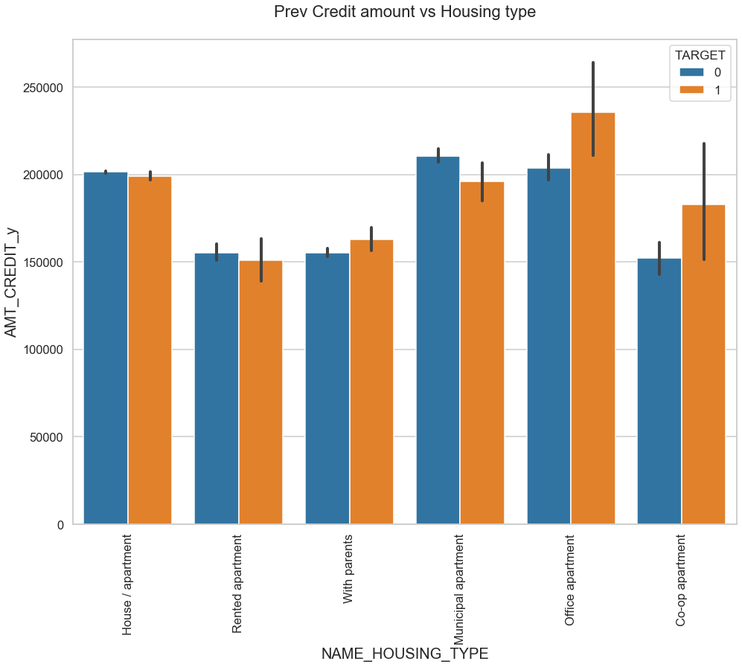
Bivariate Analysis
Loan taken for Municipal apartment are more likely to pay the loan
Loan taken for Office apartment are more less likely to pay the loan

Slide 28
Thank You

